Slide 1

AgriVision
Presented By:
Aravind
Naresh
Kalyan
Notes:
kalyan

Slide 2

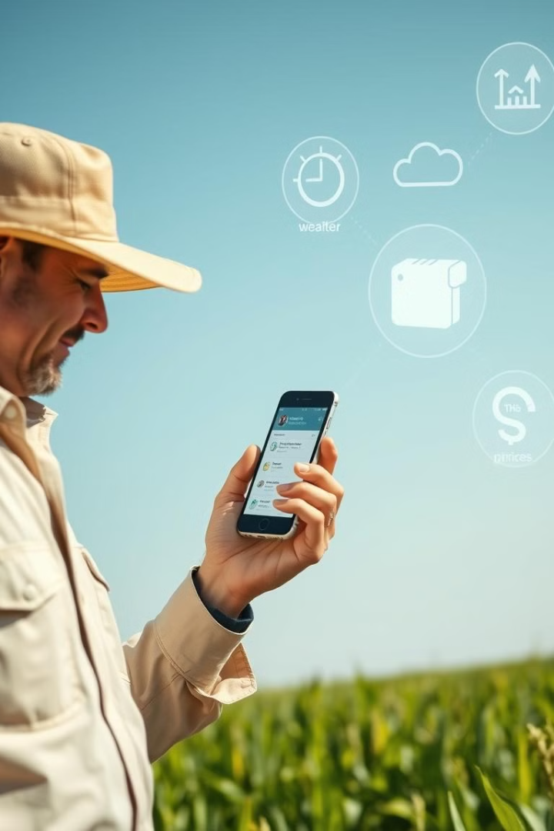
AgriVision: Revolutionizing Agriculture through Technology
Welcome to AgriVision, a project designed to transform the agricultural industry through innovative technology solutions. We envision a future where farming is more efficient, sustainable, and accessible to everyone. This presentation will explore how AgriVision will streamline farming, selling, and buying processes, making agriculture a more rewarding experience for all.

Slide 3
Project Overview: Streamlining Agriculture
Mission:
Vision:
Our mission is to connect farmers, consumers, and sellers through a user-friendly platform, revolutionizing the agricultural industry.
We envision a sustainable agricultural ecosystem that benefits all participants—farmers, consumers, and sellers alike.
AgriVision aims to leverage cutting-edge technologies. By implementing smart farming techniques, optimizing supply chains, and facilitating direct consumer-producer interactions, we'll create a more efficient and transparent agricultural system. Together, we can transform the way food is grown, distributed, and consumed, ensuring a greener and more sustainable future for generations to come.

Slide 4
Seller Profile: Manage Your Products
Add Products
Delete Products
Edit Profile
Effortlessly upload and showcase your agricultural products with an intuitive platform. Provide detailed descriptions, set competitive pricing, and manage inventory with ease, ensuring your listings are clear, accurate, and ready to attract buyers.
Effortlessly manage your listings by removing products that are out of stock or no longer available for sale. This keeps your inventory accurate, ensures your store remains professional, and helps customers find only what is currently available.
Easily update your seller profile by editing personal details, such as your name and contact information, and company details, like business name, address, and registration number. Keeping this information accurate and current helps build trust with customers and ensures smooth communication."

Slide 5
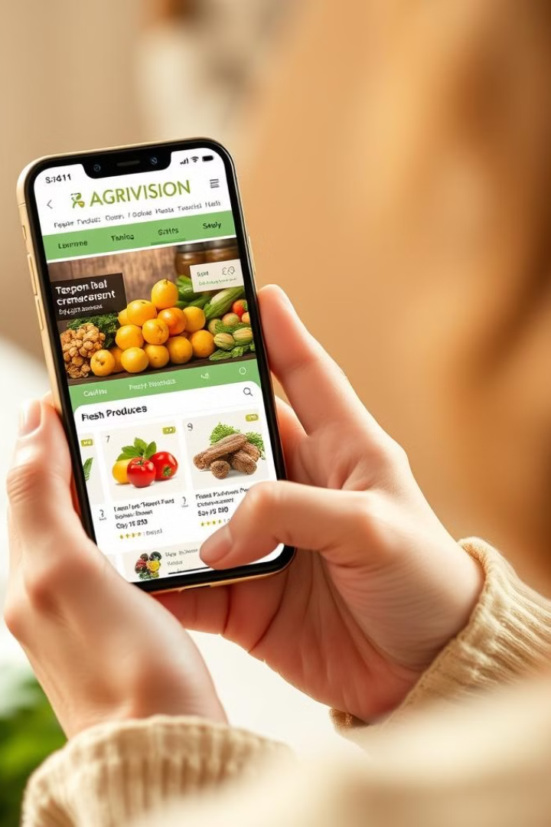

Farmer Profile:
Add your farm in just a few minutes and showcase your farm to potential buyers. Provide a detailed description of your farm including the products you grow, and your sustainable farming practices. Ensure that your farm stands out amongst others and attract the right buyers you're looking for.
Add/Delete Grains
Edit Profile
Easily update the inventory of your harvested grains, ensuring that your offerings are accurate and up-to-date.
Customize your farmer profile, including your personal information, farm details, and contact details.
Access Services
Buy Items
Utilize Agri Vision's suite of services, such as weather monitoring and precision farming tools, to optimize your operations.
Purchase essential items like seeds, pesticides, and rent farming equipment directly through the platform.
Engage with Customers
Build a strong connection with your customers by engaging with them through the platform. Respond to inquiries, provide personalized recommendations, and gather feedback to improve your products and services.

Slide 6

Consumer Profile: Personalize Your Experience
Buy Materials
Edit Profile
Browse and purchase agricultural products directly from farmers and sellers, all in one convenient platform.
Customize your consumer profile with your personal information and preferences.
1
2
3
Manage Address
Add, update, or remove your delivery addresses to ensure your orders are sent to the correct location.

Slide 7
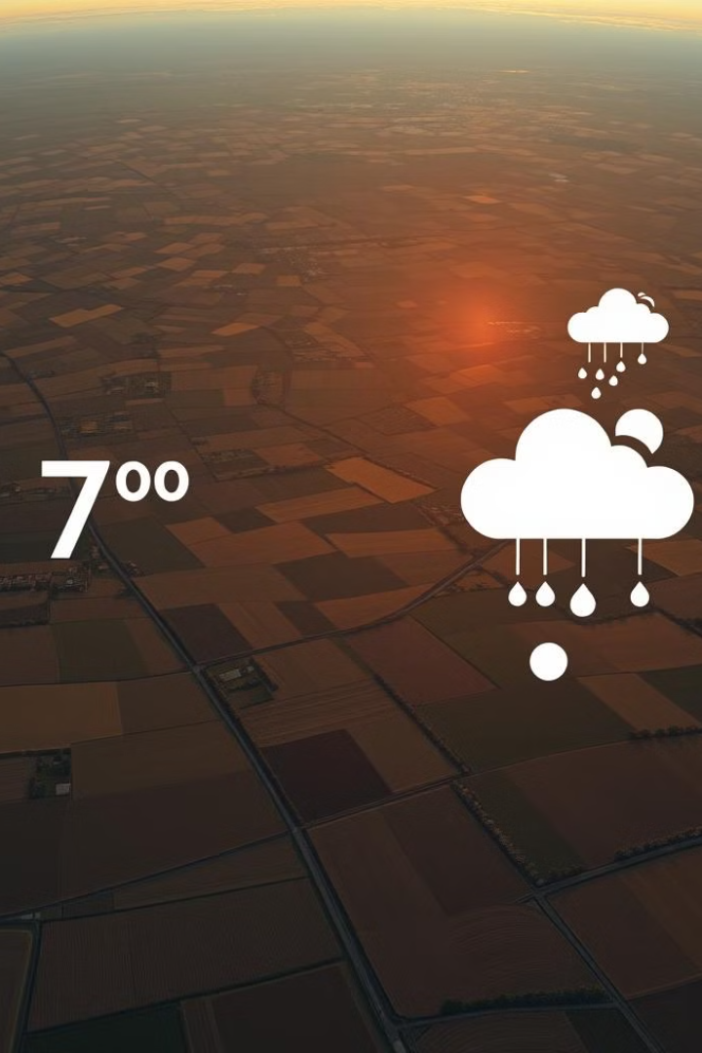


Weather Monitoring and Precision Farming
Weather Monitoring
Precision Farming
Access real-time weather data and forecasts to help farmers make informed decisions about their crops and operations.
Utilize advanced technologies, such as GPS-guided tractors and drones, to optimize resource usage and increase productivity.

Slide 8
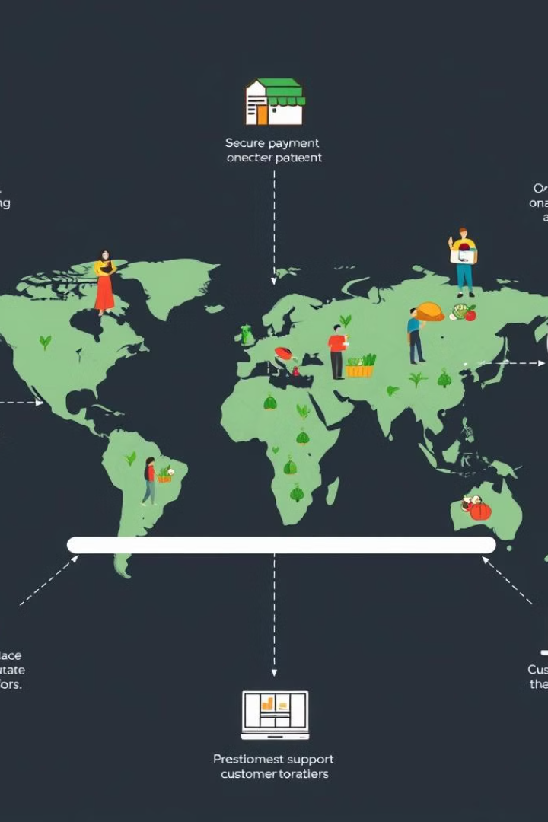



Empowering the Agricultural Ecosystem
Seamless Connectivity
Agri Vision bridges the gap between farmers, sellers, and consumers, enabling efficient communication and collaboration.
Data-Driven Insights
Harness the power of data analytics to make informed decisions, optimize operations, and drive sustainable growth.
Innovative Solutions
Leverage cutting-edge technologies, such as IoT and AI, to revolutionize the agricultural industry and improve overall productivity.

Slide 9

The Vision: Transforming Agri-Business with Agri Vision
1
Empowered Farmers
2
Enabled Sellers
Sellers can efficiently manage their product offerings, expand their customer base, and optimize their supply chain through the platform.
Agri Vision provides farmers with the tools and resources to streamline their operations, increase yields, and enhance profitability.
3
Engaged Consumers
Consumers can access a wide range of agricultural products, gain transparency into the supply chain, and support local farmers.

Slide 10
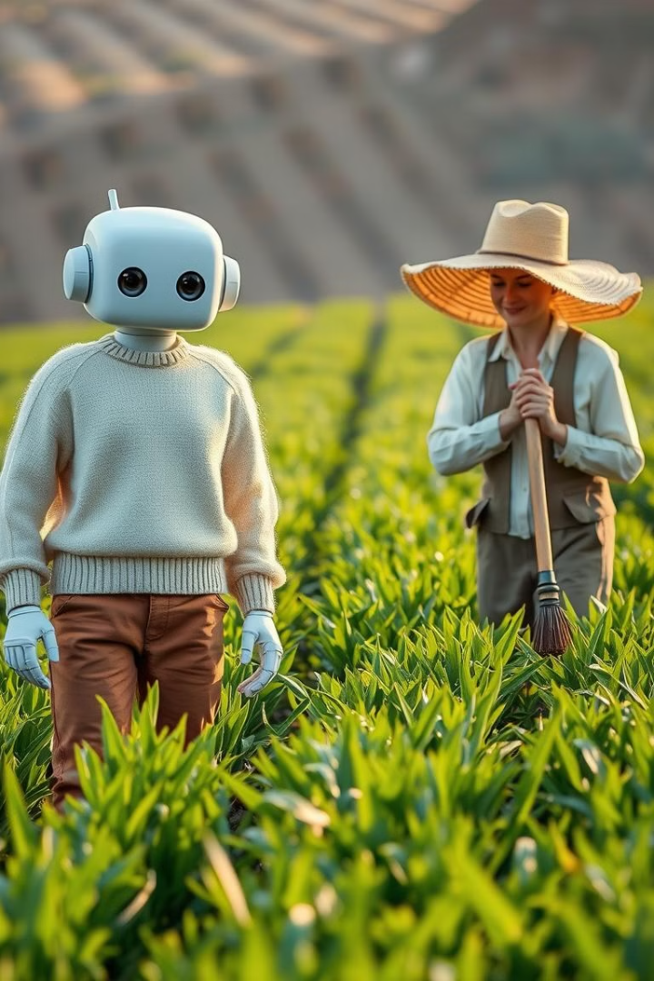
24/7 Chatbot Assistance for Farmers
Empowering farmers with immediate access to vital information and guidance, anytime, anywhere.
The 24/7 chatbot assistance feature ensures that farmers have access to vital information and guidance whenever they need it, regardless of their location or time of day. This instant support can help address their concerns, provide real-time solutions, and further streamline their decision-making process.

Slide 11
Empowered Farmers, Enabled Sellers, Engaged Consumers
Farmer-Centric Platform: Agri Vision eliminates the need for middlemen, allowing farmers to directly connect with buyers and sellers.
Fair Pricing: Farmers can now negotiate fair prices for their crops and livestock, ensuring they receive the full value of their hard work.
Streamlined Operations: Farmers can easily manage their farming needs, from purchasing supplies to selling their products, all within the Agri Vision ecosystem.
Expanded Market Access: Farmers gain exposure to a wider consumer base, enabling them to expand their customer reach and increase sales.
Collaborative Ecosystem: Agri Vision fosters a connected community where farmers, sellers, and consumers work together to support the agricultural industry.
Through Agri Vision's collaborative ecosystem, farmers, sellers, and consumers come together to share valuable knowledge and resources, fostering an environment of collective growth. This platform not only empowers farmers but also enables sellers to efficiently connect with potential buyers, increasing market opportunities. Additionally, engaged consumers can directly engage with farmers, offering feedback and building stronger connections within the agricultural community.

Slide 12
PROJECT SNAPSHOTS
AND
OVERVIEW

Slide 13
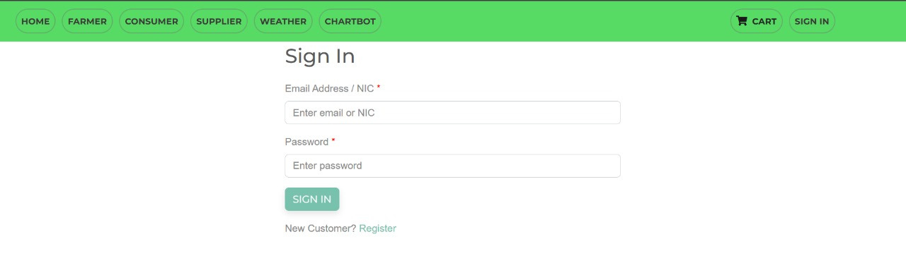
LOGIN PAGE
Notes:
PROJECT SNAPSHOTS AND OVERVIEW

Slide 14
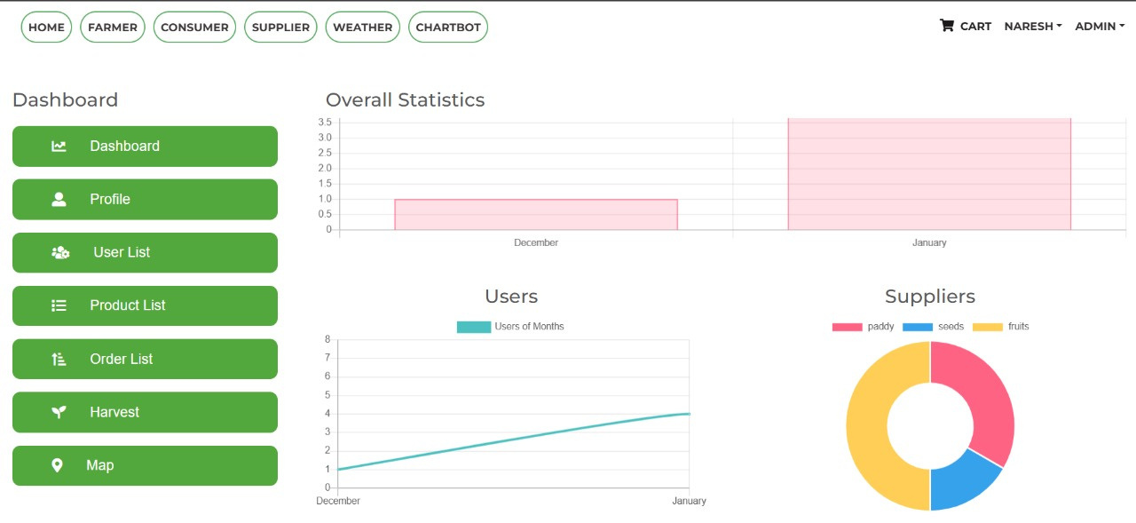
ADMIN DASHBOARD

Slide 15
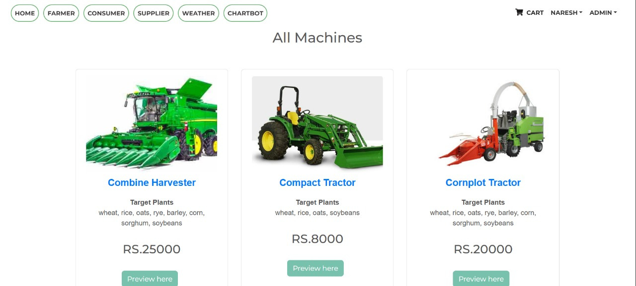
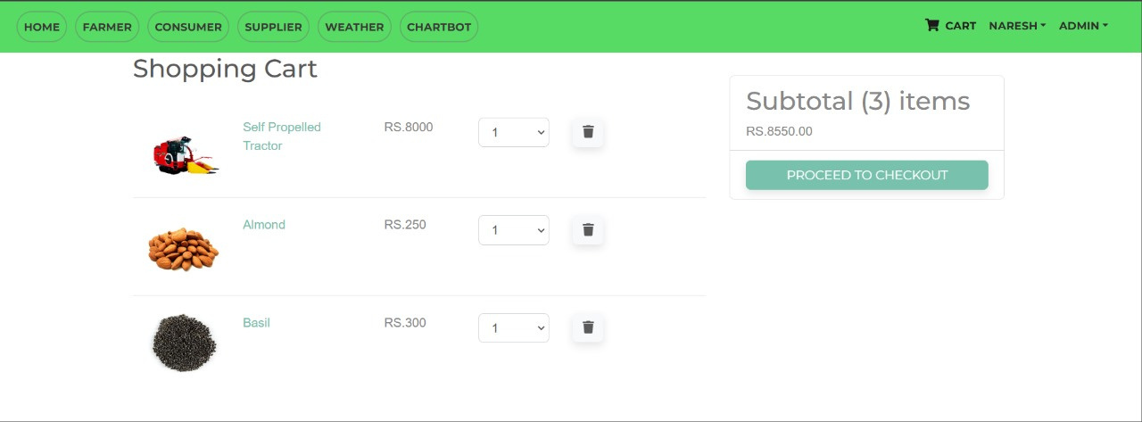
MACHINERY MANAGEMENT
SHOPPING CART

Slide 16
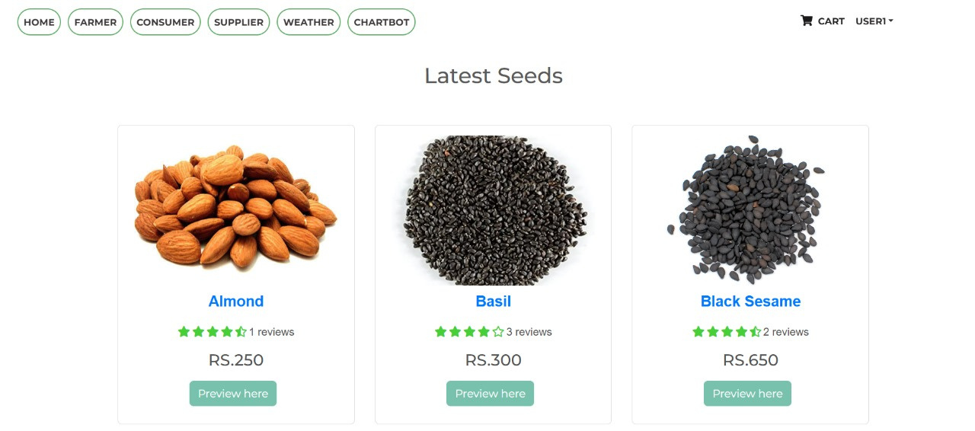
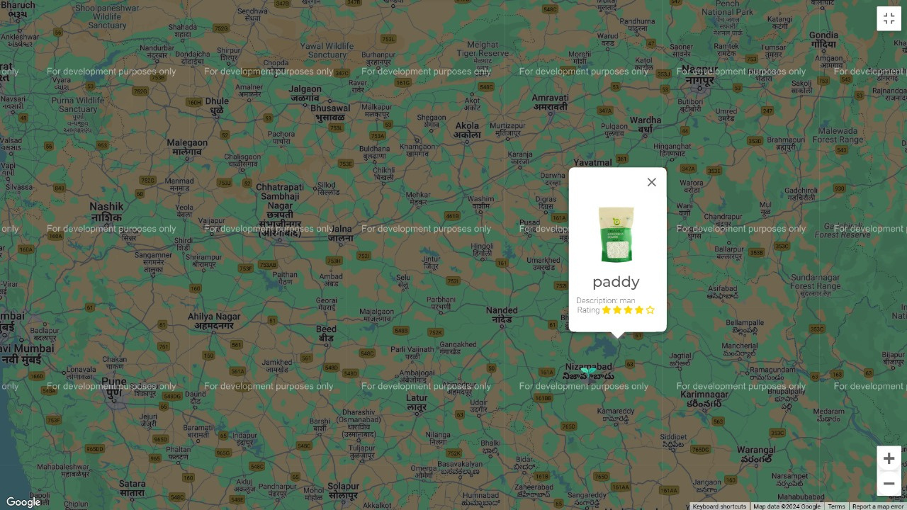
ORDERING PAGE
LOCATION TRACKING
AND
WEATHER

Slide 17
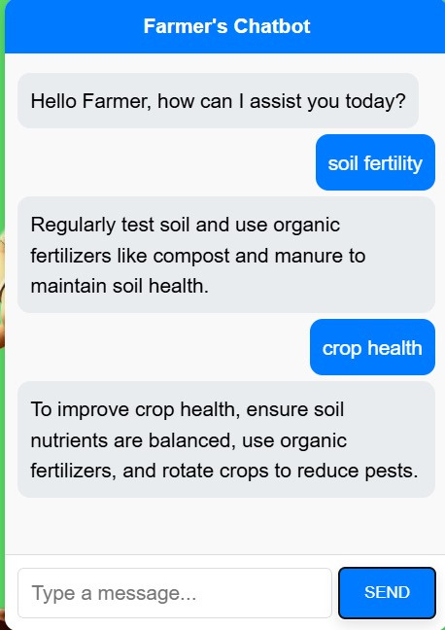
24/7 CHAT-BOT INTERFACE

Slide 18

Thank You
We sincerely appreciate your partnership and support. Your trust in our vision has been instrumental in shaping the future of agriculture.

